Slide 1
A Disaster Housing Primer

Slide 2
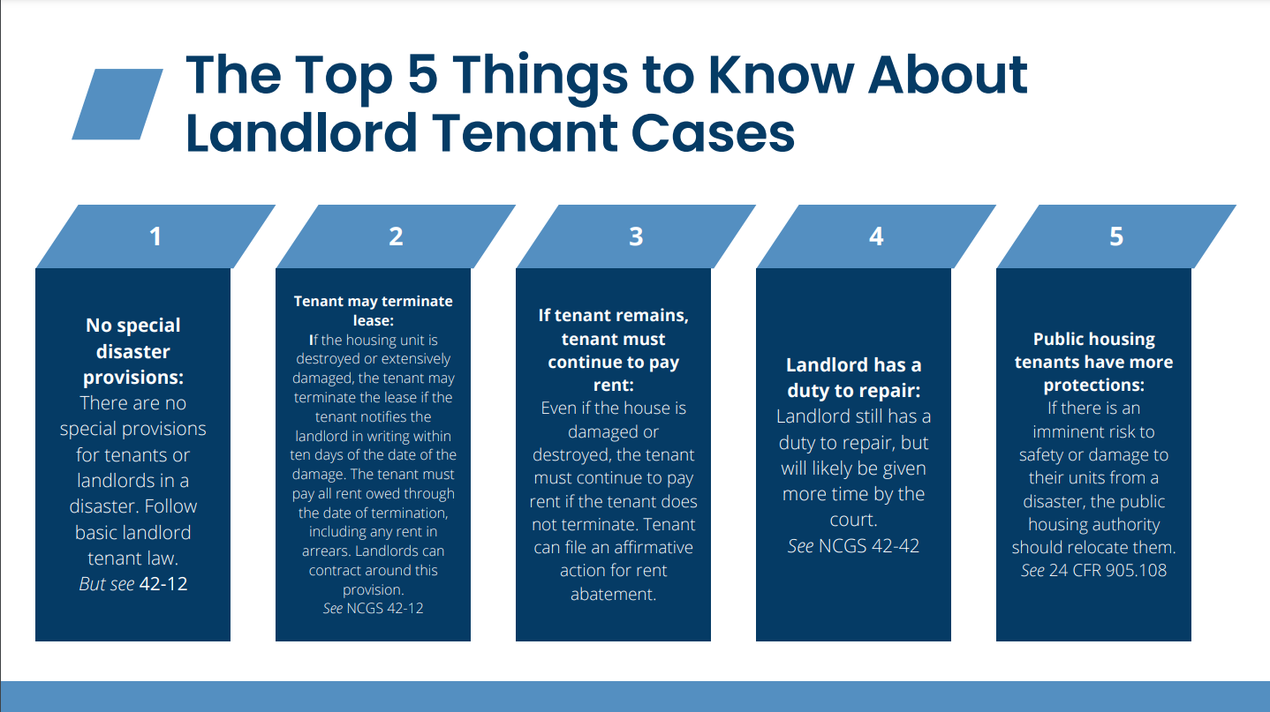

Slide 3
Disaster Tenant Rights: Private Housing
Under NCGS 42-12, Tenant may choose to terminate tenancy if building destroyed or damaged but need to notify Landlord in writing within 10 days from the damage/destruction.
Under NCGS 42-9, Landlord is allowed to end the tenancy if more than half of the home is damaged due to fire.
Under NCGS 42-42, Landlord still has a duty to repair HOWEVER be mindful of resources in the direct aftermath.
If a Tenant wants to remain in the property, they will need to continue to pay rent (encourage negotiating a smaller amount during repairs, etc.)
There are NO special codified eviction protections in the aftermath of a natural disaster

Slide 4
Disaster Tenant Rights: Subsidized Housing
If residents face an imminent health/safety risk based on damage to their units because of a natural disaster (24 CFR 905.108) the PHA should immediately relocate residents.
A PHA may use one or more of the following relocation options:
  Other available public housing units
  Section 8 vouchers from its existing HCV resources
  Section 8 vouchers through an award of tenant-protection vouchers (TPVs) from HUD
  Temporary housing (including assistance from FEMA)

Slide 5
Disaster Tenant Rights: Subsidized Housing
A PHA may choose to demolish a public housing unit portfolio and is not necessarily required to rebuild.
If the PHA relocates tenants to housing that does not meet the criteria of comparable housing (24 CFR 970) the PHA must offer residents comparable housing as part of a bid to demo or otherwise displace residents.

Slide 6
Fair Housing
There are often many, many fair housing violations in the aftermath of a natural disaster.
Some examples:
  Shelter sites requiring Latinx evacuees to produce proof of identity and residence before allowing shelter access
  Aid not distributed in areas with migrant farmworkers
  Shelter restrictions (such as families with children)
  Accessibility and reasonable accommodations for people with disabilities
    Medical needs, mental health needs
    Attempts to shelter people with disabilities in nursing homes or other restrictive settings
  Assistance animals

Slide 7
Federal Emergency Management Agency (FEMA)
Temporary rental, lodging (hotel), or displacement assistance
Transportation/vehicle repair assistance
Personal property repair or replacement
Medical, dental and funeral expenses
New(ish): serious needs assistance of $750
Note: Tenants cannot apply for home repairs. The homeowners must do this application with FEMA.

Slide 8
Otherwise General N.C. Housing Law Applies…
…the leniency for “reasonable time to repair” may just be more generous given transportation and supply issues.

Slide 9
North Carolina Gen. Stat. 42-42
Landlords MUST...
  Keep premises in “fit and habitable” condition.
  Obey local Housing Code
  Repair “imminently dangerous conditions” in a “reasonable” amount of time based on “severity” (imminently dangerous defined by statute)
  Keep common areas safe
  Keep electrical, plumbing, sanitary, heating, air-conditioning, and other facilities and appliances supplied in good & safe working order
  Install smoke and CO detectors
Landlord’s duties cannot be waived.

Slide 10
Timeline of Repair Issues
If landlord doesn’t repair, then…
Tenant moves in & signs lease
Repair issue happens
Tenant reports repair issue to landlord
Tenant contacts Code Enforcement for free housing code inspection
Tenant takes landlord to court for rent abatement

Slide 11
Code Enforcement
If landlord does not fix repairs in a reasonable amount of time, tenant should call local code enforcement.
  This could be county or city-based code enforcement. Ask us if you cannot find local contact information for your client.
Code enforcement comes out free of cost to inspect the property.

Slide 12
Code Enforcement
If there are housing code violations, the inspectors will draft a notice of violations for the owner/landlord to fix within a specified amount of time.
If owner/landlord does not fix the violations within the period, the local government will start fining them.
  Tenant does not see this fine money but threat of fines often encourages owners/landlords to make repairs.

Slide 13
Retaliatory Evictions
Retaliatory evictions are illegal.
  Landlords cannot evict or decide not to renew a lease because tenant made repair request or called code enforcement.
Tenant should continue to pay rent.
  Landlord can file an eviction case for nonpayment of rent, even while repairs are pending. NCGS 42-37.1
  While repair issues can be used defensively against a nonpayment eviction case, if the rent abatement amount determined by the judge doesn’t outweigh the amount owed the tenant can still be evicted. Not impossible, just risky.

Slide 14
Rent Abatement for
Breach of Implied Warranty of Habitability
Tenant may be entitled to rent abatement (retroactive rent discount/money back) from landlord if repairs are not made in reasonable time period.
  Can file affirmative money owed claims in small claims court, up to $10k.
    If over $10k, can file in District Court.
  Can file counterclaims in eviction case.
  LANC has a guide to small claims court on our website.

Slide 15
Breaking Leases Early
What penalties a Tenant may face for breaking a lease early depends on what is written in the lease.
If the lease is periodic (week-to-week, month-to-month), Tenant can end the lease at any time as long as they give proper notice.
  Same as if Landlord is terminating/not renewing a periodic lease.
Tenants are allowed to break lease WITHOUT penalty if:
  Need to break as a reasonable accommodation for a disability.
  Need to break because Tenant is a victim of domestic violence.
  Need to break because of military reassignment/move.

Slide 16
Mold
Mold is tricky for two reasons:
  It requires expert testing to determine which strain(s) of mold are present in the living environment. Code enforcement does NOT do this testing and will often refer to any potential mold as “bioorganic growth”.
  There is often a personal injury component to mold claims when its presence appears to impact the health of the client or another household member.
Doesn’t mean mold claims cannot be successful, but there are added layers of proof needed and we should advise clients of this.

Slide 17
Urgent Situations
Tenants often live within developing situations. If any of the following come up, please consult with a Legal Aid attorney to see if it needs to be referred to a local office.
  Tenant got eviction court papers
  Tenant got subsidy termination papers

Slide 18
Basic Advice for Tenants Post-Helene
If tenants are still in the property, they should continue to pay their rent. Otherwise landlord could file for eviction based on nonpayment.
If tenant wants to terminate the lease and it’s after the 10 days provided in NCGS 42-12, they should come to an agreement with the landlord and get this in writing. Tenant owes rent through the date of lease termination unless otherwise agreed between the parties.
Landlords have a duty to repair but will likely be given additional time right now by the courts to do so.

Slide 19
Basic Advice for Tenants Post-Helene
Tenants should report repair issues to their landlord in writing.
Tenants should document repairs (pictures, receipts, videos, code reports) in case they want to bring a claim for rent abatement later.
Tenants can apply for FEMA and disaster unemployment assistance if they need temporary lodging or income.
If the home is no longer accessible based on a tenant’s disabilities, they may have the option of requesting a reasonable accommodation to terminate lease or ask for a different unit (if available).

