Slide 1
Disaster Relief Issues Affecting Homeowners
Notes:
Good afternoon, everyone. Thanks for joining us this afternoon for our presentation on Disaster Relief Issues affecting both homeowners and tenants. My name is Daniel DiMaria and I’m an attorney with Legal Aid of North Carolina’s Disaster Relief Project. I’d like to review with you some of the most pressing issues that attorneys and legal services will be addressing for clients in need immediately after a disaster. These are the most common issues that we’ll be asked to address on behalf of clients that have just had a disaster affect their ability to live safely in their homes and how to address those issues that they’ll come up against in putting their lives back together.

Slide 2
Issues affecting homeowners

Slide 3
Issues affecting homeowners
Continue mortgage payments?
Insurance?
Avoiding scams

Slide 4
Do I have to keep paying my mortgage?
ff

Slide 5
Do I have to keep paying my mortgage?
ff
YES
BUT most lenders will work with homeowners to address an inability to pay through loan modification
FHA backed mortgagors have additional options that may be exercised including:
Loan Modification
Moratorium on foreclosure for delinquent homeowners
Adjustment of tax filing, payment deadlines
Notes:
So one of the most common questions we get from homeowners after a storm has significantly damaged a home or severely affected somehow a homeowner’s ability to pay is “do I have to keep paying my mortgage?” And the simple answer is YES.
Most home loan documents require the homeowner to make mortgage payments even after a disaster. This is true even where the house is damaged and the owner can no longer live in it. However, many lenders will allow the owner to delay mortgage payments for several months after a disaster. Interest will almost certainly continue to accrue but it does relieve some of the pressure of a disaster, and such loan modifications that allow the homeowner to miss payments will almost always simply add those missed payments to the loan, thus lengthening the term of the mortgage. The borrower needs to communicate with their lender and tell them about the specifics of the circumstances. The lenders will nearly always work with their customers.
If the FHA guarantees the mortgage, there are special provisions after a disaster that could allow homeowners many different options. We’ve already discussed loan modifications. Homeowners could also apply for a moratorium on foreclosure if they are unable to pay the mortgage. You could apply for this if i) you or your family live within the geographic boundaries of a Presidentially-declared disaster area, you are automatically covered by a 90-day foreclosure moratorium; ii) you are a household member of someone who is deceased, missing or injured directly due to the disaster, you qualify for a moratorium, or iii) your financial ability to pay your mortgage debt was directly or substantially affected by a disaster, you qualify for a moratorium.
A Foreclosure Moratorium applies only to borrowers who are delinquent on their FHA loan. If you are current on your loan payments, then you should continue to make them. FHA lenders will automatically stop all foreclosure actions against families with delinquent loans on homes within the boundaries of a Presidentially-declared disaster area.
It is very important that homeowners notify their lender to be sure that they realize they are an affected borrower. The lender may request supporting documentation and use it to determine if you meet the relief criteria. Once identified as an affected borrower, foreclosure action may be stopped for the duration of the moratorium period.
If your home was damaged in the disaster or you will not be able to make your monthly loan payment(s) because your finances were adversely affected, contact your lender immediately to request assistance.
Borrowers who were injured or whose income relied on individuals who were injured or died in the disaster will be asked for documentation such as medical records or death certificates, if available. Your lender will ask you for financial information to help evaluate what assistance can be provided to you to reinstate your loan.
Disaster declarations may also postpone certain tax-filing and tax-payment deadlines established by the IRS.

Slide 6
Insurance, insurance, insurance
ff

Slide 7
Insurance, insurance, insurance
ff
No one but the homeowner is responsible for what’s lost
Homeowners insurance is not flood insurance
Know what the policy covers
Notes:
Ok, so let’s talk about INSURANCE. It’s absolutely essential for any of our clients who are homeowners because no one but the homeowner is responsible for fixing the home and replacing its contents. Homeownership is still a legitimate path to wealth generation and maintaining intergenerational wealth but all of that is lost without insurance.
Another brief word for the uninitiated: homeowners insurance is not flood insurance. Basically, flood insurance covers the policy holder for losses incurred when water comes at you over the ground such as rainstorms that flood your yard, lakes that overflow, or storm surge. Like homeowners policies, flood insurance covers your house and possessions.
Homeowners insurance does cover many types of water damage. If your pipes burst and flood your house or your toilet overflows or, most germane to our state, if rain comes through a hole ripped out of your roof by a hurricane, homeowners insurance pays. It won’t pay, however, if you were negligent, such as knowing about a roof leak and didn’t bother to fix it. If a roof leak or a pipe break results from age and deterioration, insurance will only cover the damage to your house contents, but not roof or pipe repairs.
Depending on your insurance company's underwriting and your location, you may need a separate windstorm and hail policy, if it is excluded from your primary homeowner's policy. Earthquakes are another thing that is not covered by a standard policy even if you live in an area, like NC, where serious earthquakes are highly unlikely. Talk with your agent to make sure you are covered.

Slide 8
Insurance, insurance, insurance
ff
CONTACT
Insurance adjuster
NCDOI
Mobile disaster units
ALERT
List of ALL damages ASAP
SECURE
Required by policy
Can DIY or hire contractor
Expenses reimbursed
Not at risk of safety
Notes:
Now that all of our clients have homeowners and flood insurance forever, they should be advised on how to make the most of those policies in the wake of a disaster. In most cases, we’re going to be speaking with clients after a claim denial so while our opportunities to solve a problem before it occurs are gone, we can still can check to see that the client has done the initial legwork with their insurance provider to secure their claim – denial or no.
First, they have to call their insurance agent or provider. This should be done as soon as it is safe to do so. Their knowledge of what is damaged and how is not vital at this point – all that a claimant needs to be able to say is that the home was damaged by the disaster. When a disaster occurs, most major insurance companies establish disaster hotlines for their policyholders. The lists of insurance company hotlines are generally posted on the websites of the various state departments of insurance. Also, major insurers often set up mobile disaster units close to affected areas. There should be no excuse for not being able to contact insurance ASAP – which is exactly what the insurance company itself will tell us if our clients only come to us after they’ve waited too long. What is a reasonable time to take in calling them is circumstantial of course – a homeowner could be kept from returning to where their home is located by emergency authorities for weeks. However, most policies specify within sixty (60) days.
Next, we want to have alerted the insurance provider to our damages. This should be done before anything else. Ask the client for cell phone pictures of their damages. Ask for a list of what is observed to have damage so that you can keep track of those things that need repair or replacement as we’ll check this against what’s covered by policy to make sure the client is getting everything they’re entitled to. If they have not done this by the time they contact us, this is step one. These lists should also include every single piece of personal property that needs to be repaired or replaced. The insured may be eventually be asked to provide an estimate of these items’ value in a proof of loss so it’s best practice to do this well before major repairs begin because a lot of this stuff is then going to be disposed of – one may not remember it all.
Finally, you want to assess client’s securing of the home by doing reasonable repairs to stop further damage from happening. This is all the more important because homeowners policies mostly require a homeowner to undertake these efforts.
An example of this would be to turning off a water source for a burst pipe and leaving it off or placing a tarp on your roof to prevent water from coming into the house.
You also want to consider what temporary repairs you can make in advance of the insurance provider’s inspection or authorization of the claim. This is a bit more than placing a tarp on the roof. An example would boarding up a broken window or doorway to prevent entry to the home or mucking out the house and putting in fans or dehumidifiers to dry it out and prevent the proliferation of mold.
A homeowner can do this themselves if they think they’re capable or solicit a contractor. Advise the client of the wisdom of soliciting estimates from potential contractors. Ask your clients for their receipts of anything they’ve done because reasonable expenses to protect the property are part of the loss and may be reimbursed by your insurance company. While all of these activities are covered as part of a homeowners policy, policy limits may be eaten up by these initial repairs.
Keep in mind that you don’t have to do this at the risk of your own safety. As long as the homeowner is making some concrete effort towards securing the home, one should be in satisfaction of the policy’s requirements for temporary repairs.

Slide 9
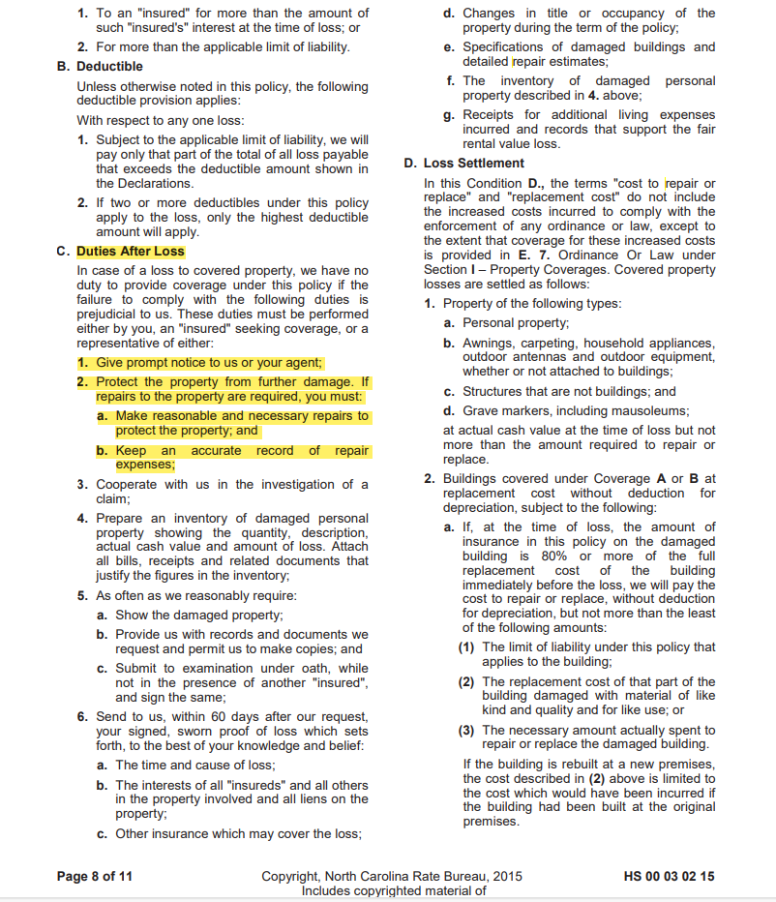
Sample Policy including duties of homeowners
Notes:
Here’s a sample policy that includes the language mandating that a homeowner protect the property from further damage and to make any reasonable and necessary repairs to do so.

Slide 10
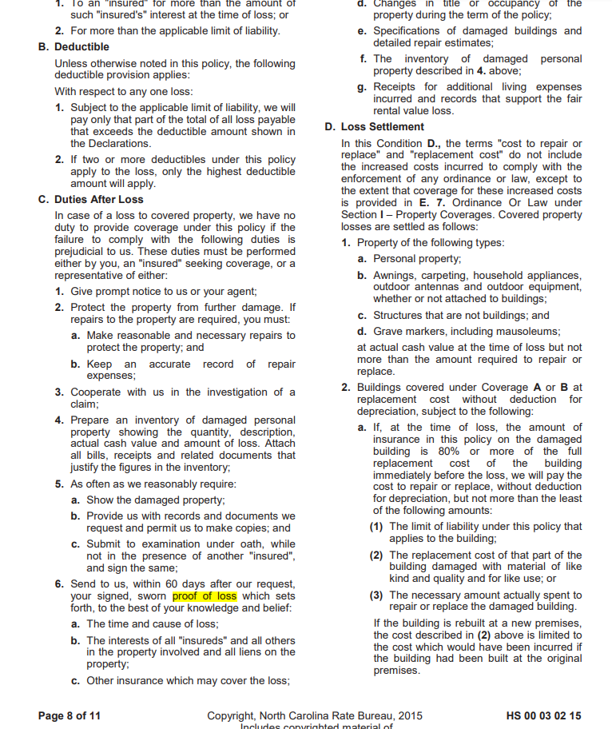
Disputing claim denials
Just like with FEMA, this is where we start to craft record for future actions
ff
Get the policy and check the coverage
Know what is and isn’t (commonly) covered
Disputing negative outcome on insurance claim
Review denial, supporting paperwork
Call the adjustor
Lodge a reconsideration, appeal
Contact NCDOI, file complaint
Can assist with resolution within serious limits
Checking, executing the proof of loss
Policies require proof of loss typically within sixty (60) days
But may be delayed by statute for disaster declaration
Notes:
After we’ve checked our clients’ initial work, if they’ve submitted a claim and that claim was denied in whole or in part, we want to confirm the bases for the denial. Just like with FEMA, this is where you’re going to begin crafting your record for whatever we need to do next. My aim is to assume I’m going to trial and collect as much data to inform that possibility as I can.
The first thing we want to do is get a copy of the policy and check its coverage, with focus on the denial and its factual bases according to the insurer but also as a general exercise to know what’s covered to ensure our clients get their coverage’s full measure.
Recall my reference to most policies requiring a separate windstorm/hail/earthquake policy, We probably won’t be doing anything with earthquakes in NC, but windstorm and hail damage are weather events that aren’t unknown here and do damage across the state even without a disaster declaration. Is that the source of the client’s damage?
You can get this from the client but, even if you do, ask the insurance provider for it as well. They’ll probably be the same but no reason to not check.
So with the policy in hand, we can now compare the facts of the case against the basis of denial and supporting paperwork. It may not be elucidating to the overall problem but that won’t matter because we’re going to call the adjustor anyway. You want to hear the bases of denial from them in any event. Ask questions about their review of the claim. Did they come to the house or rely on a report from a third party. Where’s the report? Where’s their report if they made one? If they didn’t, why didn’t they? Is it difficult or impossible to contact them? Do they not return your calls or respond to your emails? Do they make excuses for not contacting you or not explain the bases of the denial in a way that makes sense or jibes with the terms of the policy? This is all information that even if not helpful now will become quite useful when in litigation and you want to potentially double or treble a jury award for unfair and deceptive trade practices – more on that later.
Next, you want to assemble your argument for coverage so that you can lodge a request for reconsideration appeal. This may be in an appeal that is required by the policy, which by now would know because you’ve reviewed the policy. But usually this step is accomplished through a demand letter to the insurer.
Another option you can exercise is to file a complaint with NCDOI. NCDOI has some leeway in assisting consumers with their insurance denials. One of the principal advantages that I see from this route for attorneys is that an insurance company cannot ignore NCDOI without considerable and more immediate risks than if they continue to ignore or stonewall you. As such, the most immediate benefit is that DOI will forward a copy of your complaint to the insurance company and require the company to provide a response/explanation.
They’ll then review the company's response for compliance with applicable North Carolina statutes, regulations, and policy requirements. I advise that you double-check their work.
That said, if DOI sides with you, they would require the company to take corrective action if their denial does not comply with applicable requirements.
What they cannot do is act as your legal representative in or out of court or intervene in a pending lawsuit, on our client’s behalf. They won’t even consult with someone who’s represented by an attorney, unless they have the attorney's written permission.
Most germane to our purposes in responding to denials effectively and crafting our record is that, despite the above, DOI WILL NOT establish: i) who was negligent or at fault; the value of a claim or the amount of money owed to you; ii) the facts surrounding the claim (that is, who is being truthful when there are differing accounts of what happened); and iii) the facts regarding any other disagreement between you and another party.
Finally, it would be good to check the status of a proof of loss as completed by the client. Maybe they’ve not done this yet, but even if they did, you can submit a further, more comprehensive one. Did the client submit everything that was damaged or satisfy the policy’s requirements of what is required therein?
Keep in mind that the proof of loss typically must be completed within sixty (60) days of the date of loss.
The application of any provision in an insurance policy that requires an insured to file a proof of loss within a certain period of time after the occurrence of the loss, shall be stayed until the earlier of (i) the expiration of the disaster proclamation or declaration and all renewals of the proclamation or (ii) the expiration of the Commissioner of Insurance's order declaring that such requirements be stayed for the specific disaster.

Slide 11
Suing the insurance company
ff
Do NOT miss the statute of limitations
Measured from date of loss event – not date of alleged breach, occurrence
Verify damages and get a cost
Unfair and deceptive trade practices?
Notes:
Now, if you get through these options and are not seeing results and you know your client’s position has merit (so they should be paid), then it may mercifully be time to sue!
You’ve already crafted your record by this point and understand the facts, but there are some things that you should note when specifically litigating against an insurance company.
First, know that the statute of limitations for any cause of action against an insurance company starts to toll the day of the loss event – the date of the hurricane, the tornado, the electrical fire, whatever. We typically think of, for instance, a breach of contract action as starting at the breach but, if the breach of contract is represented by the insurance company’s denial of a claim that should have been approved, we’re thinking about it wrong.
Next we want to review our sources of damages. What verification do you already have in your assemblage of facts that the home is damaged? How will you get an estimate of the cost of repairing the damages that the insurance company should have paid? Do you have an estimate from a contractor? Consider you alternatively demonstrate the loss in the value of the home from a municipal source like tax records?
Finally, I want us all to think about including an action for unfair and deceptive trade practices. Remember our discussion on the adjustor/insurance providers response to demand for payment, offers of settlement, ignored emails, calls, etc? These are all issues we could then argue at suit to establish this cause of action of UTP. Not only can you treble the damages established by the finder of fact, but attorney’s fees may also be available if the court finds either that the insurer willfully engaged in the act or practice, and there was an unwarranted refusal by such party to fully resolve the matter
which constitutes the basis of such suit OR the insurer knew, or should have known, that their denial was frivolous and malicious,
The North Carolina Supreme Court has interpreted this provision in the context of insurance claims. In Gray v. North Carolina Ins. Underwriting Ass’n, the Court addressed the interplay between Chapter 75 and Chapter 58 (regulation of insurance). See, generally, Gray v. North Carolina Ins. Underwriting Ass’n, 352 N.C. 61 (2000). According to the Court, a violation of Chapter 58 supports a violation of Chapter 75, and the insured need not show a general business practice of such conduct. Gray, 352 N.C. at 71. Chapter 58 requires insurers to promptly investigate claims, promptly settle claims where liability has become reasonably clear, and promptly provide a reasonable explanation of the basis in the insurance policy in relation to the facts for denial of a claim. N.C.G.S. § 58-63-15(11)(d), (m), and (n.).

Slide 12
Responding to Scams
Contractors, insurance adjusters, charities, and government agencies will flood into affected communities
Scammers appear as, and often ask for, the same things as legitimate actors
Desperation to resolve issues quickly is rife – scammers take advantage of this.
Notes:
Next I want to talk about responding to scams. A lot of the issues we’re going to discuss involve homeowners because they are paying for their repairs – either out of pocket and through their insurance company. Renters likely won’t be dealing with contractors directly in any event. Nonetheless, these are all good advice that our clients should be thinking about in the wake of a disaster.
Contractors, public insurance adjusters, charitable organizations, and government agencies all flood into disaster areas after a storm once its safe to do so. Most of these people are perfectly legitimate and at least are who they say they are. People go where the work is, and if your work is to repair or build houses in some capacity, a disaster area is a perfectly legitimate place to go. Unfortunately, these are also great opportunities for those acting in bad faith. Money, personal information, access to property – these are all things legitimate actors need to effect repairs, and the very things that scammers are after.
People’s desperation is the primary way that scammers begin to take advantage of people effected by disasters. We all want problems resolved as quickly as possible, return to a sense of normalcy. Bad faith actors are aware of this, and couch their requests in an offer appealing to this desire. “We can get started right away.” “This price is only good today, in cash.” “I need your social security and bank account numbers today or it will delay the check.”

Slide 13
Options for enforcement
File a lawsuit
Small claims, district, superior
Beware service, collection, evidentiary issues
Only then North Carolina Licensing Board for General Contractors Homeowners Recovery Fund
AG Complaint
Simultaneous with other efforts
Have options not available to civilians
File criminal charges
Can file misdemeanor charges
Need cooperation of authorities for felony
Could serve as incentive for refund
Notes:
There are several options available to go after bad faith actors and some of them are even good.
First you can file suit. Small claims is obviously the most straight forward choice if you never intend to get or couldn’t support a claim for more than $10K this could be a quick(er) fix. But you may want to or have to get into district or superior court if the damages are substantial. I’ve handled cases where contractors did, through acts or omissions or straight fraud, six figures of damage so this isn’t uncommon.
What is uncommon is being gifted with a defendant that you won’t have problems serving much less collecting a judgment against. Further, you may evidentiary issues if you end up with a client that has saved no evidence to give you. What’s right is right, but in real life you never have a perfect client and your defendants in these situations are often other poor people who may not have a fixed addressed or assets to collect on if you overcome every other example.
Contractors performing construction or repair jobs that cost $40K or more are required to be licensed by the North Carolina Licensing Board for General Contractors. This status could be easily determined on their website, along with any complaints made against the contractor through the board. Now, practically speaking, the only thing I see that our clients get out of licensed contractors is possible access to the Homeowners Recovery Fund, if the contractor was licensed, or fraudulently stated that they were, and they exhaust all other remedies for recovery, including a judgment at suit, and an open judgment that hasn’t been able to be satisfied. Licensees aren’t required to have insurance or be bonded. But you can check and see if there are any complaints or whatever.
Next, you can contact the North Carolina Attorney General’s office and file a complaint. They have some abilities, in excess of DOI and Contractor’s Board, that aren’t available to civilians. If they get enough complaints they may do something about it – they can revoke business licenses, injunctions, in addition to money to victims MAYBE.
Next, you assist a client in filing criminal charges. A client can always go to the magistrate’s office for their county and swear out a complaint for misdemeanor failure to work after pay. But the bigger gun in this showdown is felony obtaining money by false pretenses intent before the fact. Fortunately, people can’t just swear out a warrant for felonies here in NC. You would need to get DA/police involvement/cooperation to facilitate this but if the case if compelling you might be able to convince them its worth their modest effort. An advantage to criminal judgments is that they can include provisions for repayment to victims. Of course, another option could be that DA offers to drop charges if defendant can confirm the money was paid back to victims and victims corroborate.

Slide 14
Prepping for Suit
Be ready to start crafting a record for litigation
Did client get ID, keep a copy?
How did client pay? Did they get invoices, receipts?
Does the client have a written contract? What terms, scope of repairs?
Review damages, have verification thereof
NCEM inspections reports – free, objective
Issues with collecting – realistic case assessment, client expectations
ISSUE SPOTTING: contractors that don’t finish, that do a bad job, and straight scammers take money and leave
Notes:
So let’s talk about prepping for suit in these circumstances. Let’s do that by crafting our record for litigation. Similar idea for insurance providers but the information available and that will support claims is different.
Did the client ask for official ID from anyone claiming to be from the government, power company, or insurance company. All FEMA employees carry picture IDs with them. Maybe they took a picture? Could be helpful in identifying an individual or corporate defendant.
Did the client pay any contractor for work upfront? If so do they have invoices and receipts of payment? This would be able to clearly establish damages.
Did they have a written contract that detailing the work to be done and includes a completion date, work proposed to be completed and the estimated?
What are the damages? What are the verification of damages? Photos?
A great way to get an honest assessment of the state of repairs to a client’s home is to contact NCEM, as we discussed earlier. They won’t price out any of the damages and they will almost certainly not lay blame on particular issue they discover, though they may be willing to say that repairs were not done correctly if that’s what they observe.
Remember that you need to address the expectations of the client and yourself in determining what, if anything, is actionable/worth the considerable time and expense of litigation, ie. are damages sufficient to warrant litigation? What about those issues with finding the defendant and being able to collect from them? This is the time that those metrics are reviewed, analyzed, and determined.
Finally, a word on issue spotting, particularly with contactors. What sort of causes of action you are able to bring on behalf of the client, and what kind of potential criminal charges may be available, will depend upon what kind of contractor is at play.
Some contractors don’t finish: think breach of contract for those Ks that include clear terms on work to be completed or a date certain for completion. Look for terms in available Ks that like “time is of the essence”, which would make the date of completion a critical K term. Think also back to the potential misdemeanor failure to work after pay.
Some contractors do a bad job. Maybe if they complete the agreed-upon work but not well, one can’t legitimately pursue swearing out a misdemeanor such as failure to work after pay. But can you bring a breach of K COA along with a negligence action?
According to our Court of Appeals of Olympic Prod. Co., A Div. of Cone Mills Corp. v. Roof Sys., Inc., 88 N.C. App. 315, 322, 363 S.E.2d 367, 371 (1988), a duty of care may arise out of a contractual relationship as, accompanying every contract is a common-law duty to perform with ordinary care the thing agreed to be done, and a negligent performance can be a tort as well as a K breach.
Finally, there are the true scam artists, those that take money and leave without doing anything. If there’s a contract, you can still litigate on that, but, once again, we have the option to pursue UTP, under the theory that contractor absconding with payment is the type of immoral, unethical, unscrupulous, or substantially injurious act/practice that is in excess of a breach of K. In re Fifth Third Bank, Nat Ass'n-Vill. of Pendland Litig., 217 N.C. App. 199, 208, 719 S.E.2d 171, 176 (2011).
Further, a plaintiff must show substantial aggravating circumstances attending the breach to recover under the Act, which allows for treble damages.” Branch Banking & Tr. Co. v. Thompson, 107 N.C. App. 53, 62, 418 S.E.2d 694, 700 (1992). In other words, this probably won’t arise out say simply doing work poorly or violating an essential K term – even “time is of the essence”. It is highly unlikely to sustain UTP is the defendant is amidst contract performance.

Slide 15
Contact Info:
Legal Aid of North Carolina, Inc.
www.legalaidnc.org
Notes:
These are far from the only issues that our clients will face. We don’t have time to cover, for instance, prohibitions on price gouging, NC’s door-to-door sales laws and their prohibitions, unfair debt collection practices that may arise when clients are unable to pay bills due to a loss in income.

